Slide 1

Modelling Anthropogenic Climate Change
By Thomas Davies
Supervised by: Craig P. Testrow & Richard J. Wilman
Department of Physics, Durham University

Slide 2
Table of contents page.

Slide 3
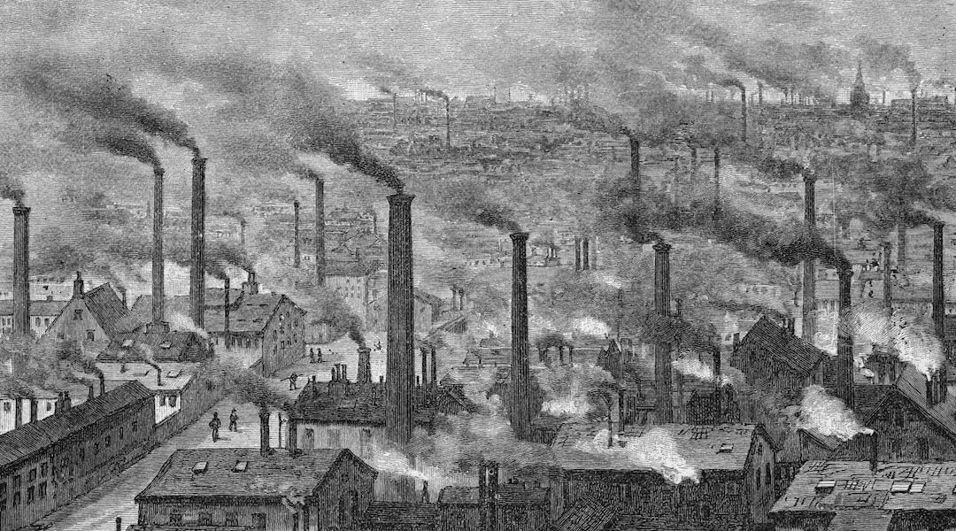
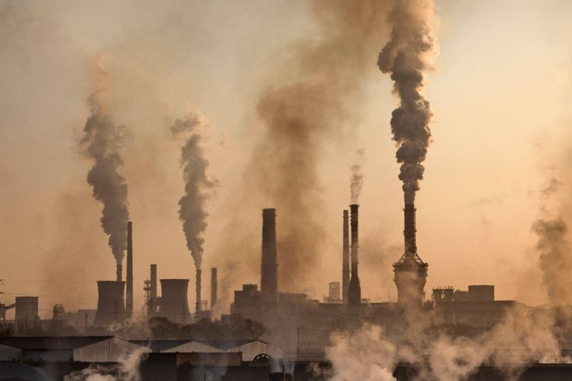
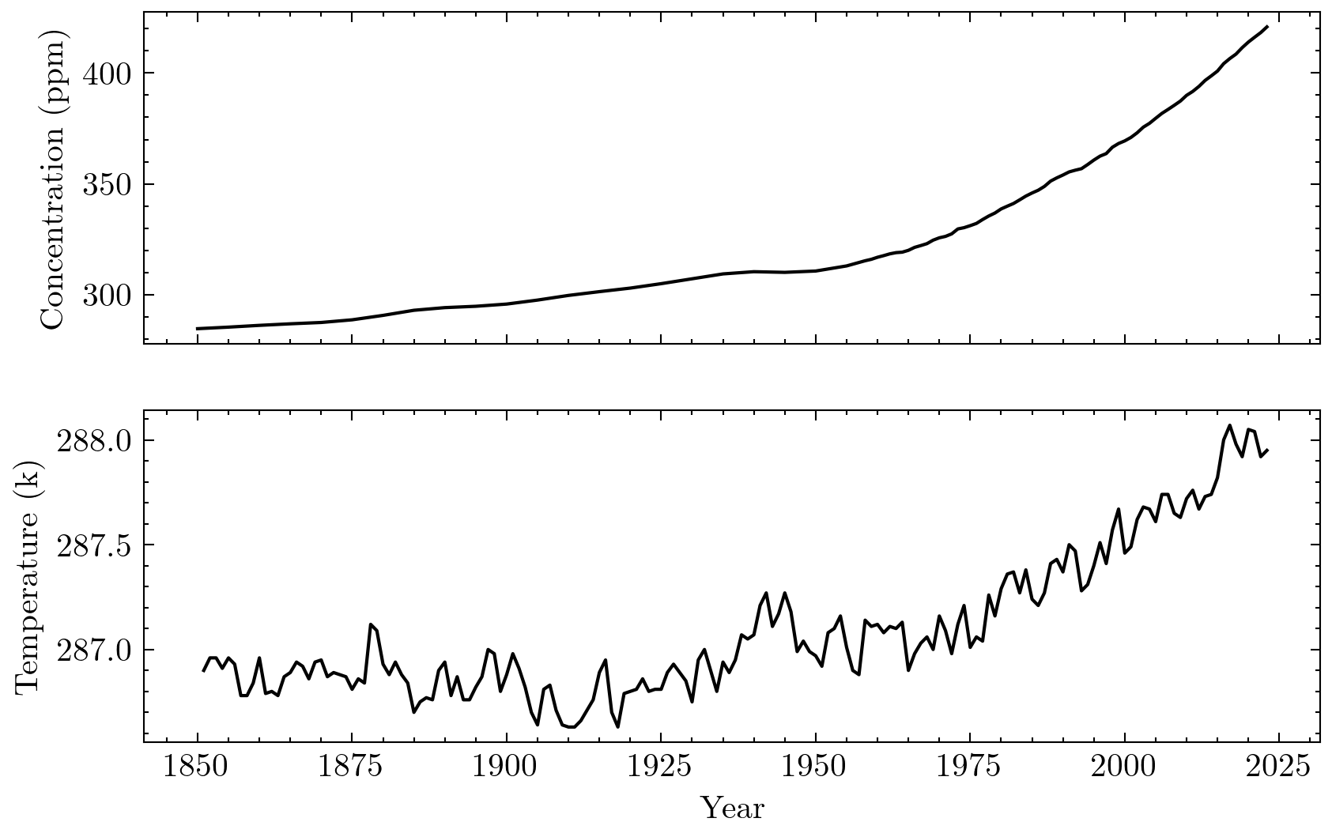
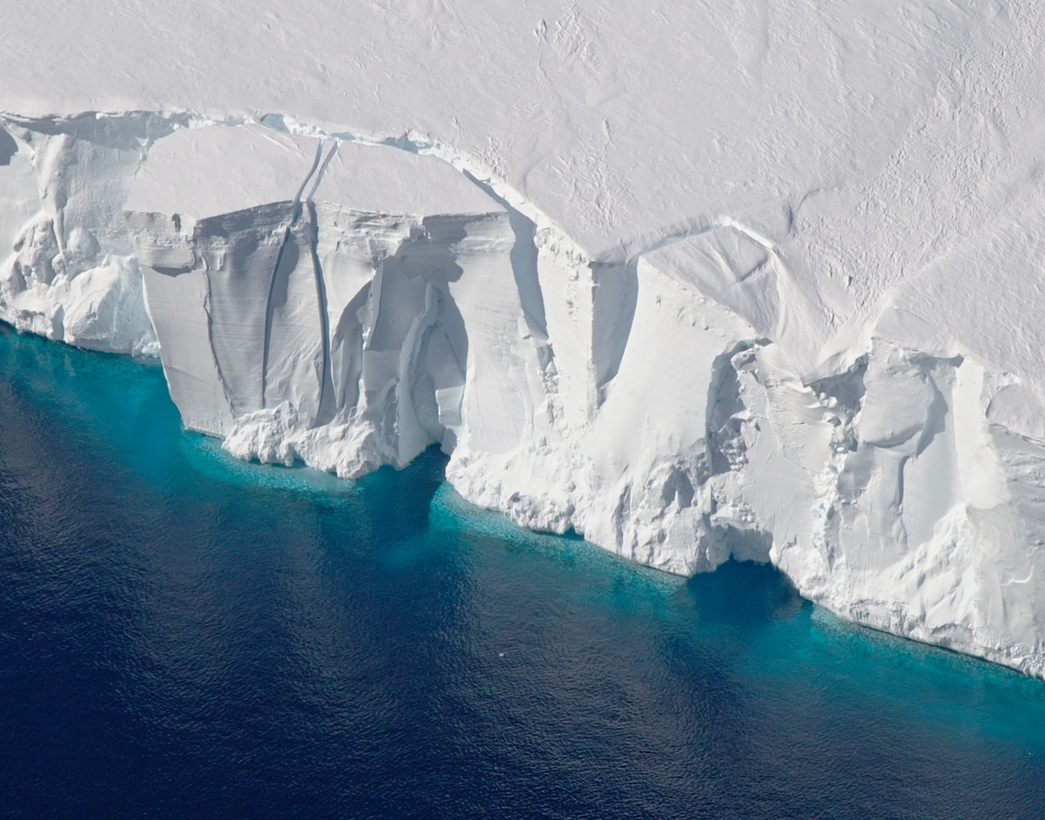
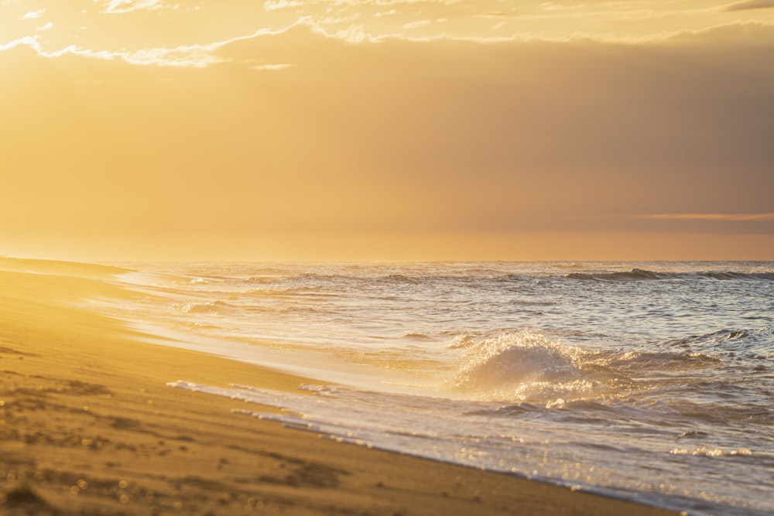
Atmospheric CO2 levels
Why is atmospheric CO2 increasing?
How does this effect global temperature?

Slide 4
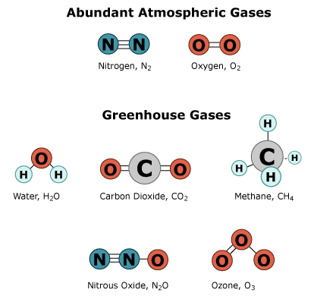
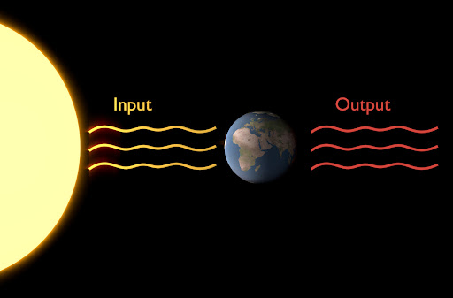
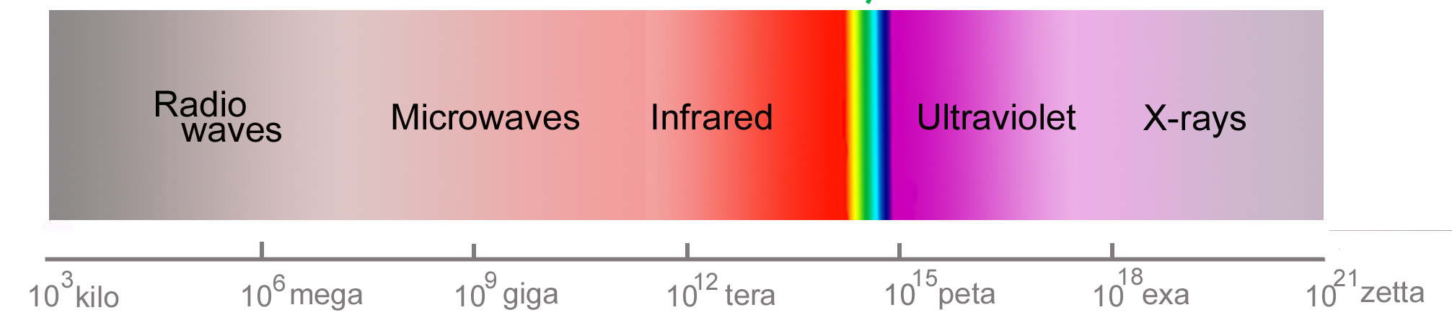
The Greenhouse effect
What is a greenhouse gas?
How do they effect global temperature?

Slide 5
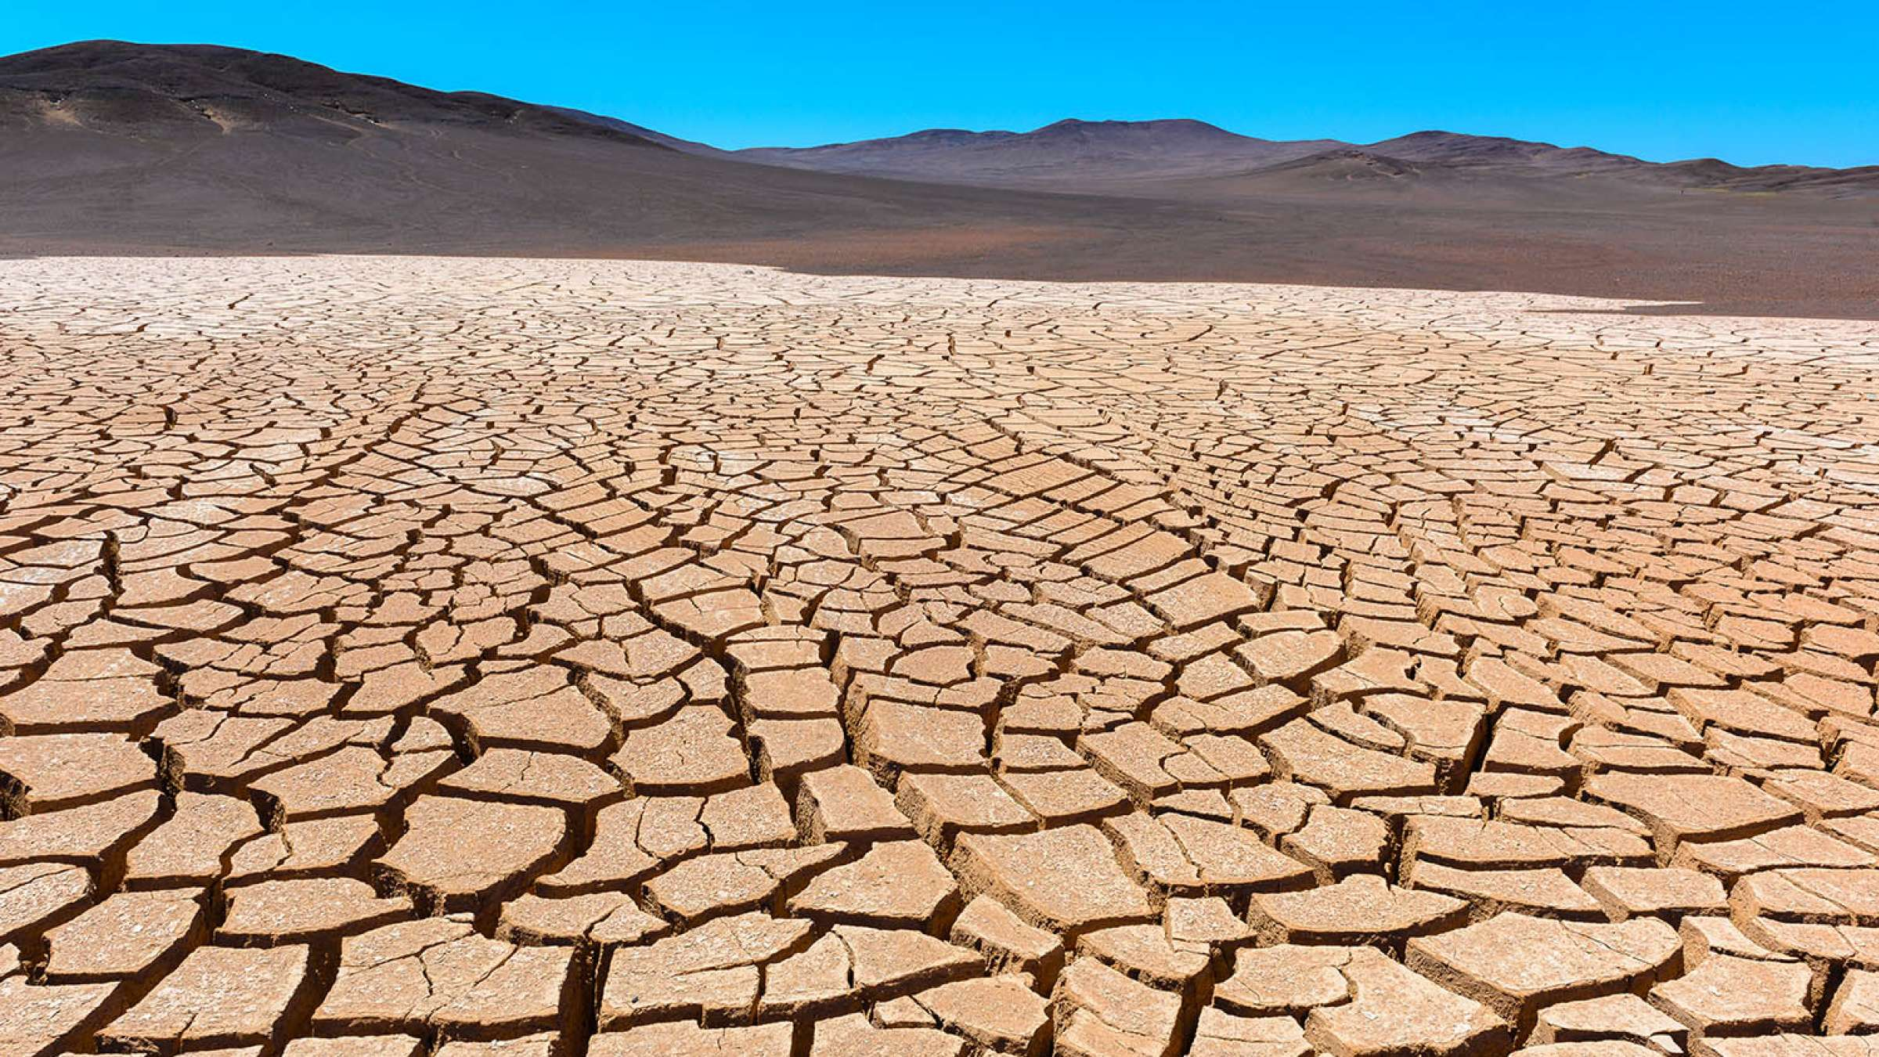
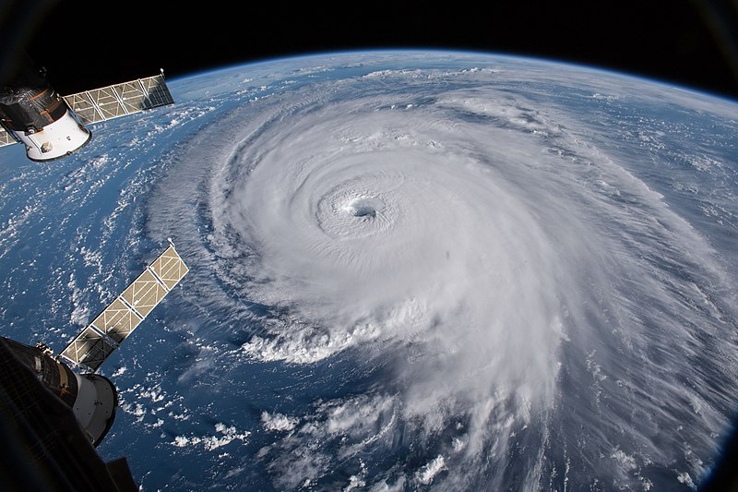
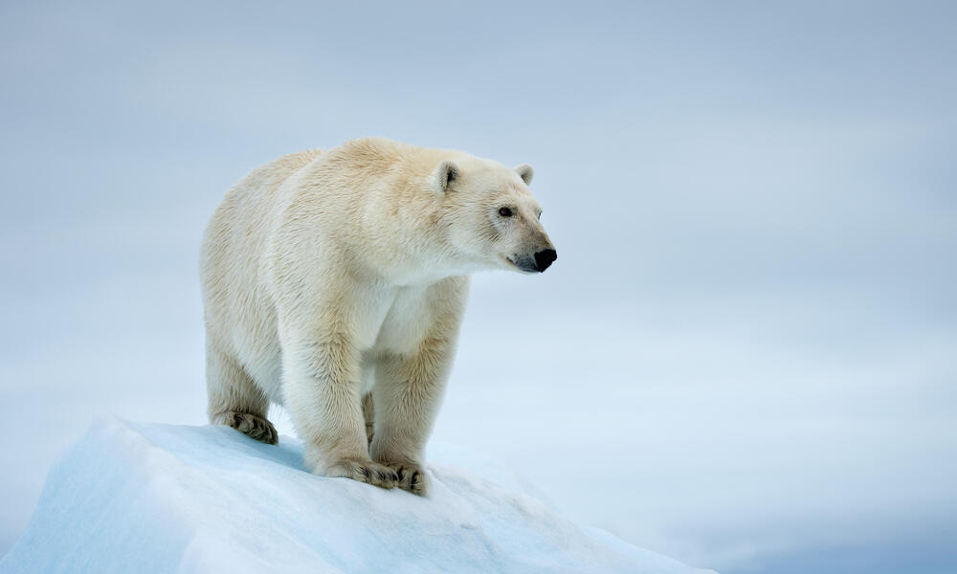
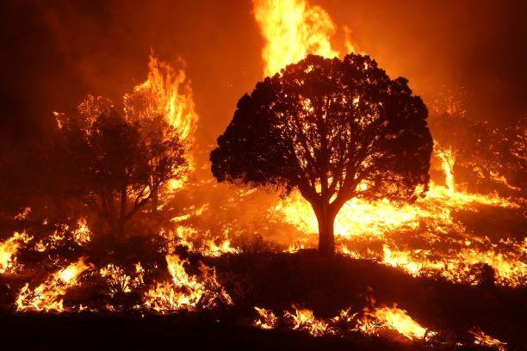
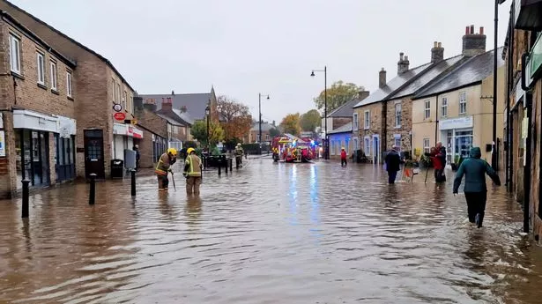
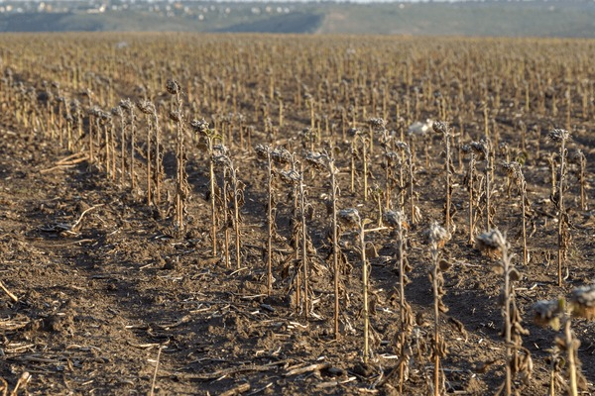
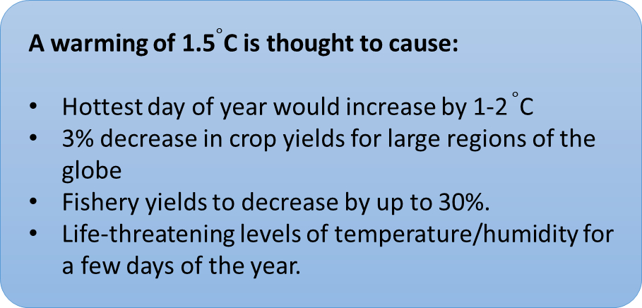
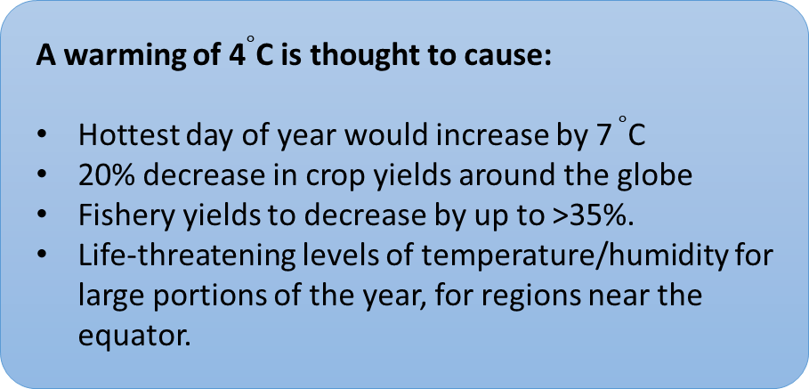
Consequences of a warming climate
A warming of 1.5$∘$C is thought to cause:
Hottest day of year would increase by 1-2 $∘$C
3% decrease in crop yields for large regions of the globe
Fishery yields to decrease by up to 30%.
Life-threatening levels of temperature/humidity for a few days of the year.
A warming of 4$∘$C is thought to cause:
Hottest day of year would increase by 7 $∘$C
20% decrease in crop yields around the globe
Fishery yields to decrease by up to >35%.
Life-threatening levels of temperature/humidity for large portions of the year, for regions near the equator.

Slide 6
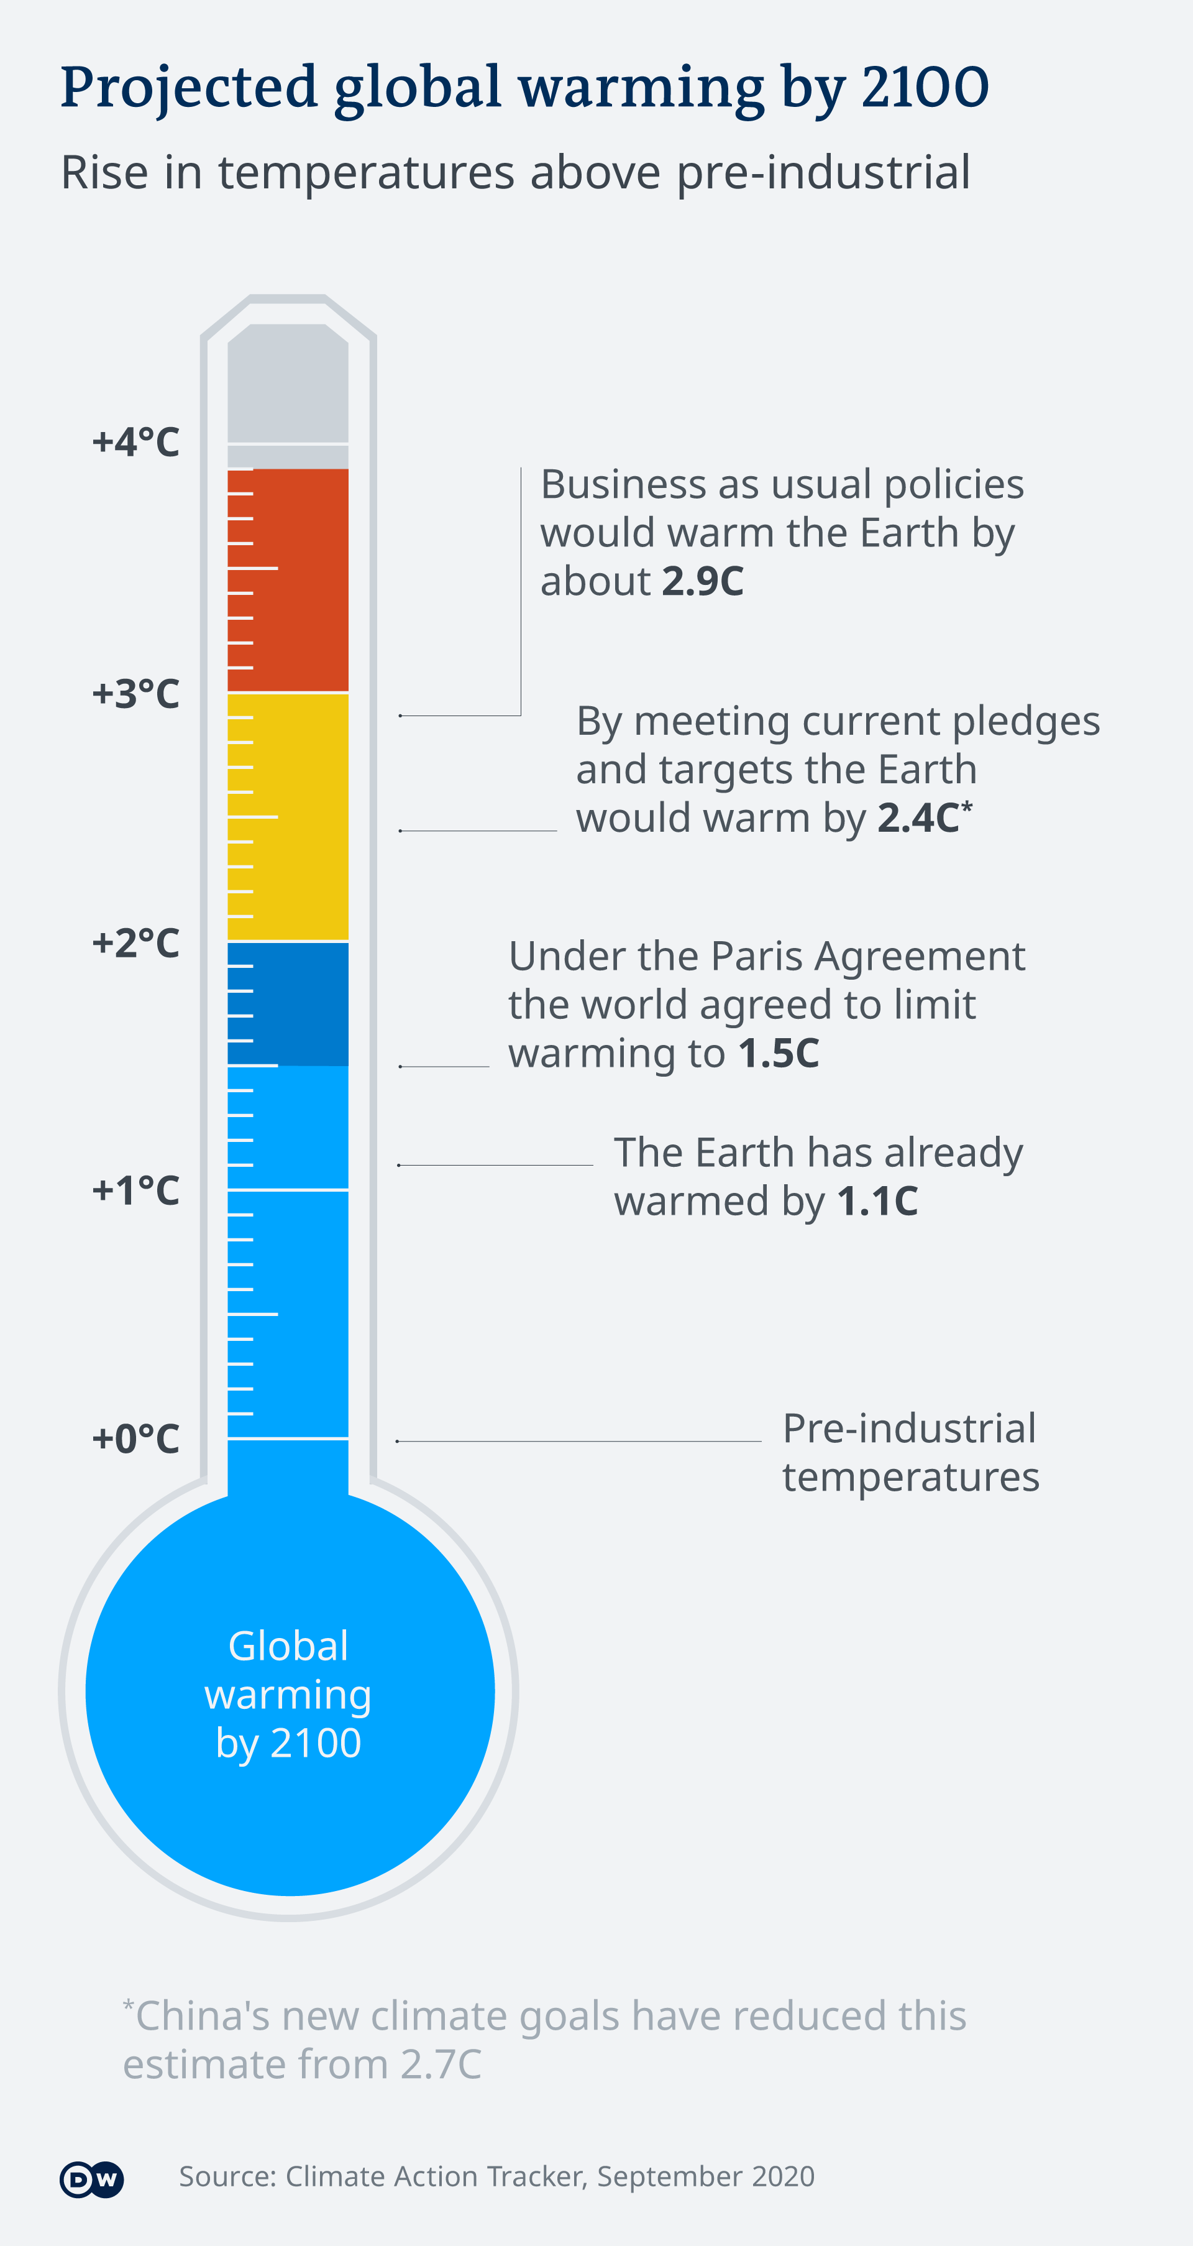
Project Aims
The Paris agreement
The next contender?
Consequences of this (wildfires, drought frequency)

Slide 7
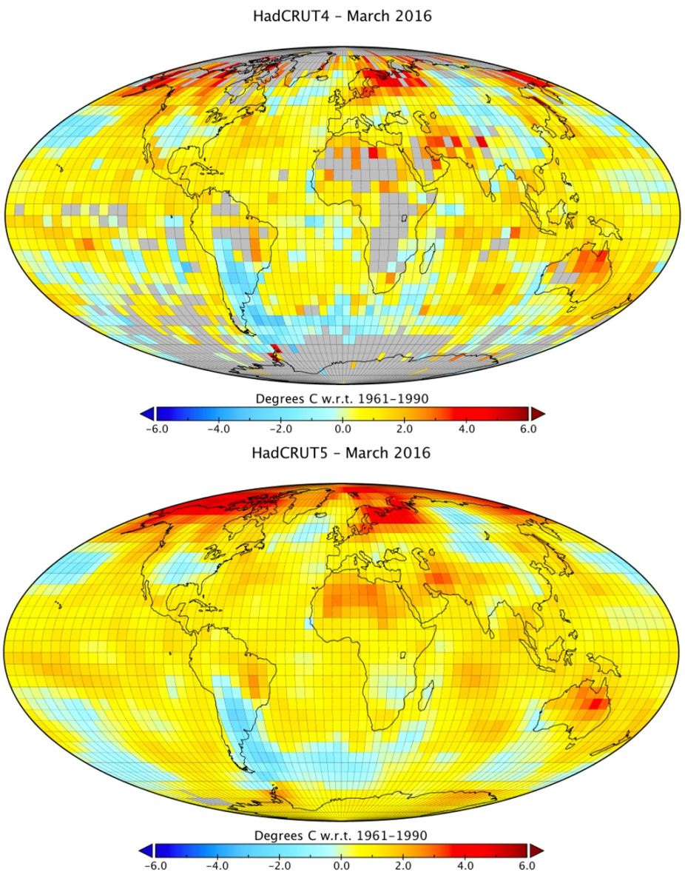
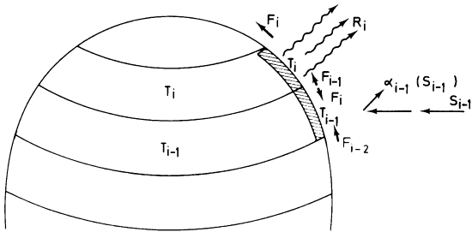
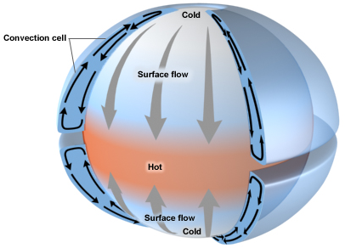
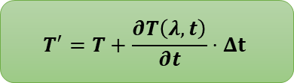
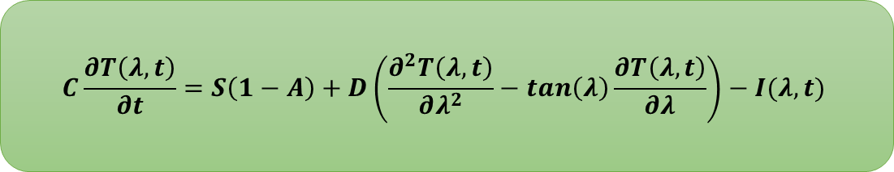
Climate Model
What is a 1-D EBM?
How do we utilise this P.D.E?
$$C\frac{∂T\left(λ, t\right)}{∂t}=S\left(1−A\right)+D\left(\frac{∂^{2}T\left(λ, t\right)}{∂λ^{2}}−\tan\left(λ\right)\frac{∂T\left(λ, t\right)}{∂λ}\right)−I(λ,t)$$
$$T^{′}=T+\frac{∂T\left(λ,t\right)}{∂t}⋅Δt$$

Slide 8
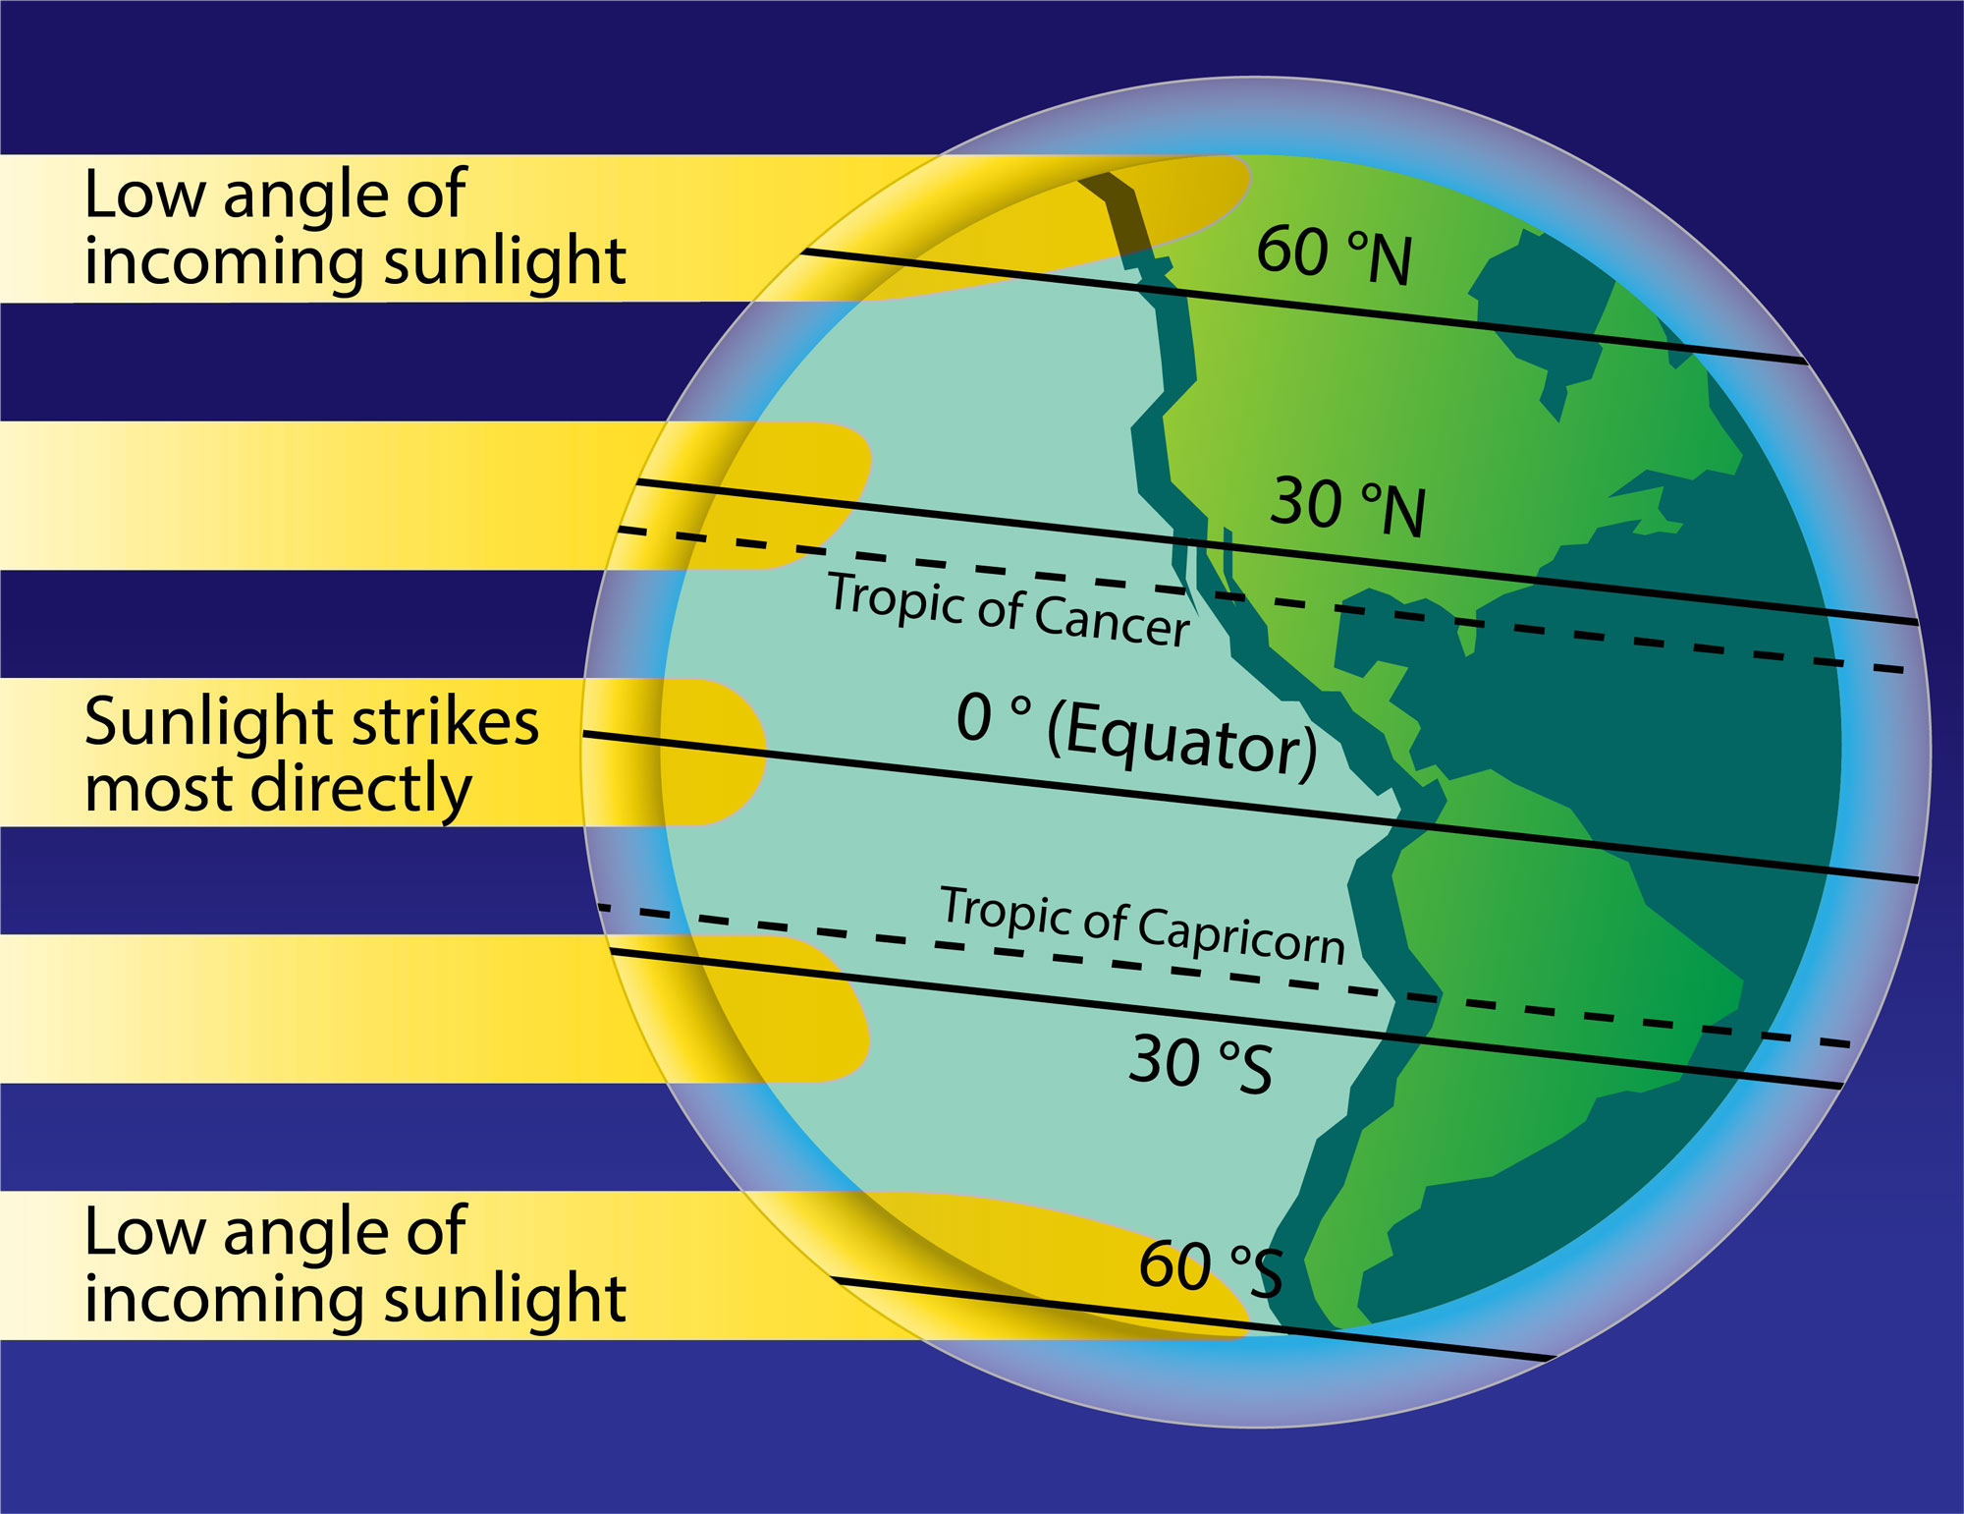
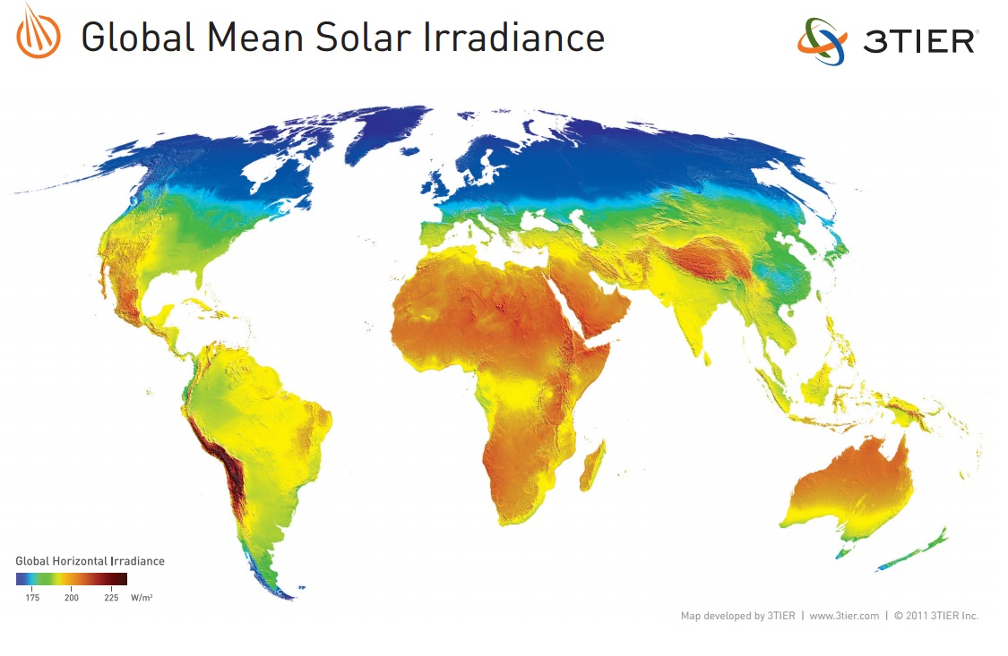
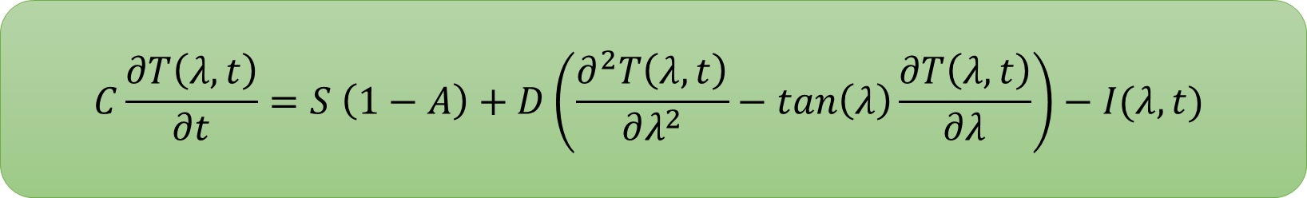
Solar Insolation
$$C\frac{∂T\left(λ, t\right)}{∂t}=S \left(1−A\right)+D\left(\frac{∂^{2}T\left(λ, t\right)}{∂λ^{2}}−\tan\left(λ\right)\frac{∂T\left(λ, t\right)}{∂λ}\right)−I(λ,t)$$

Slide 9
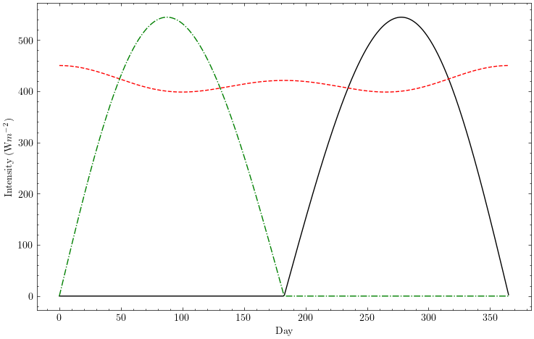

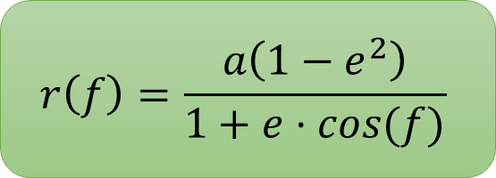

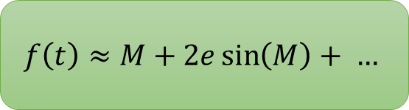
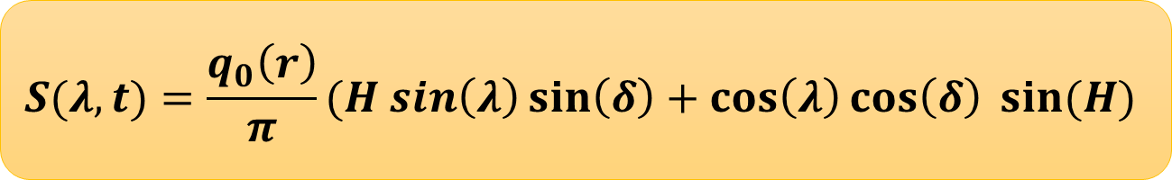
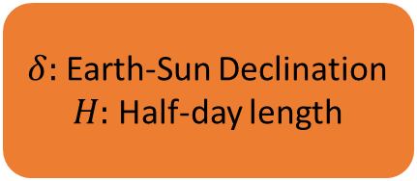
Solar Insolation
How do we calculate $S$?
$$f\left(t\right)≈M+2e\sin\left(M\right)+ …$$
$$r\left(f\right)=\frac{a\left(1−e^{2}\right)}{1+e⋅cos(f)}$$
$$q_{0}\left(t\right)=\frac{L_{sol}}{4π r^{2}}$$
$$S(λ,t)=\frac{q_{0}\left(r\right)}{π}(H sin\left(λ\right)\sin\left(δ\right)+\cos\left(λ\right)\cos\left(δ\right) sin⁡(H)$$
$δ:$ Earth-Sun Declination
$H:$ Half-day length

Slide 10
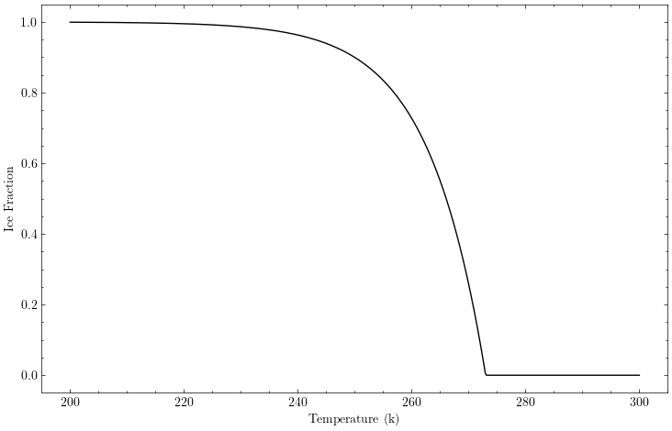
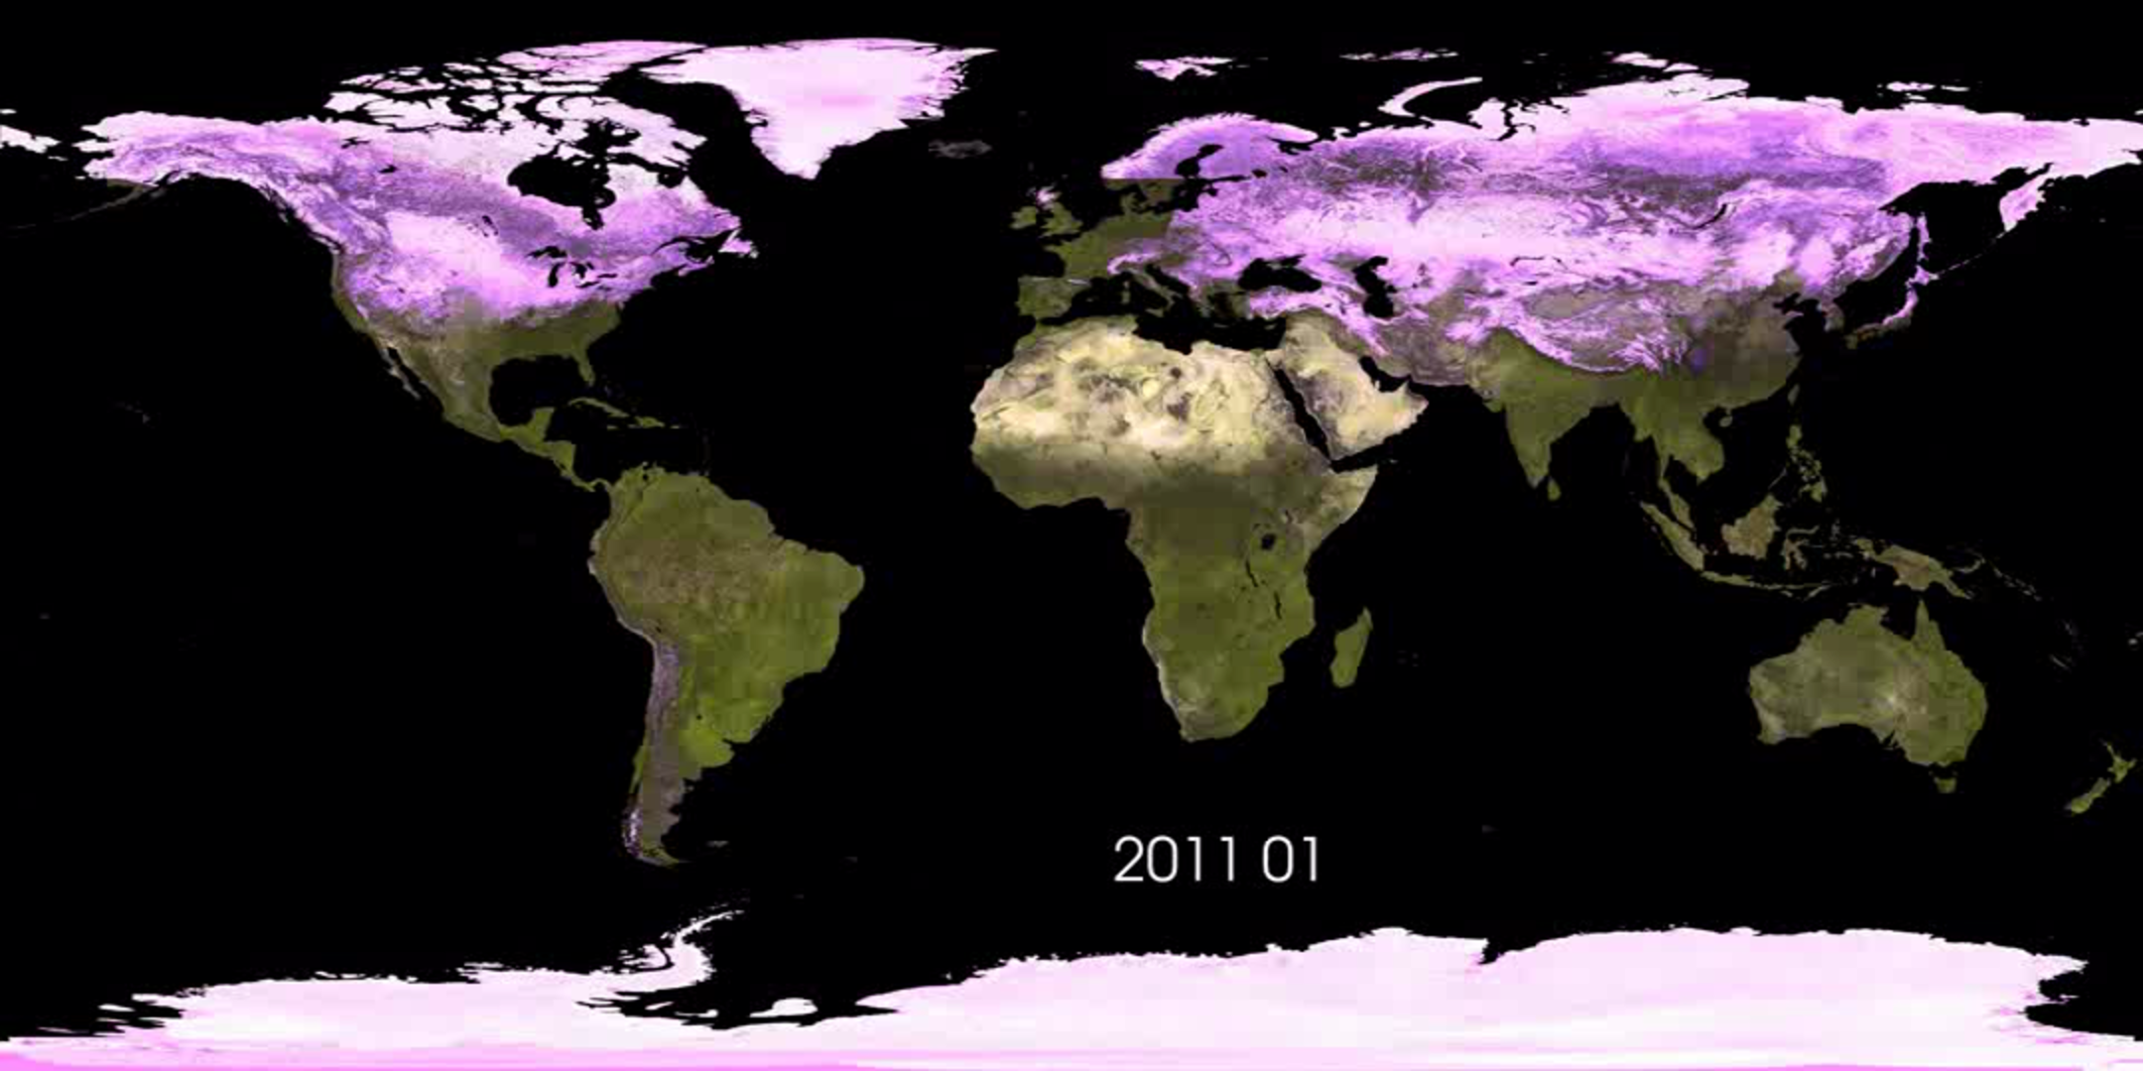
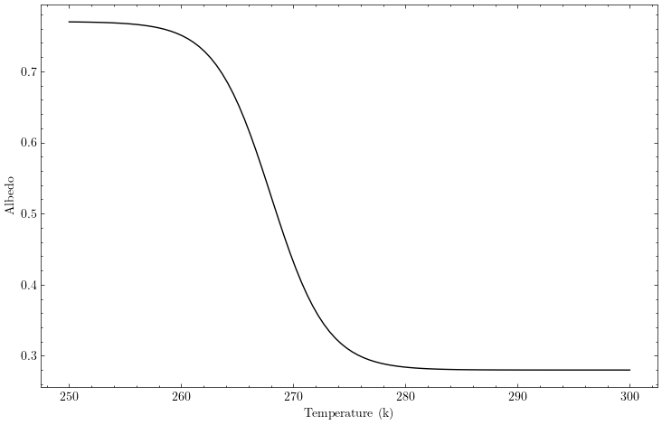
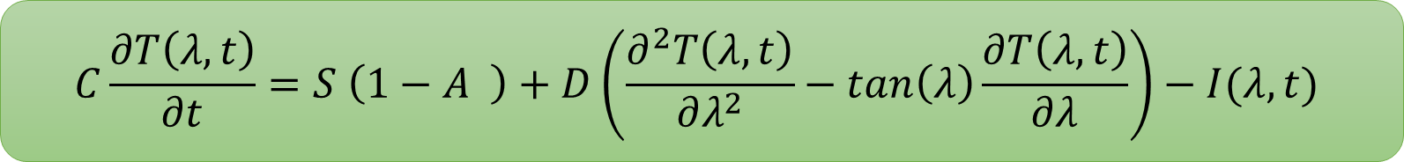
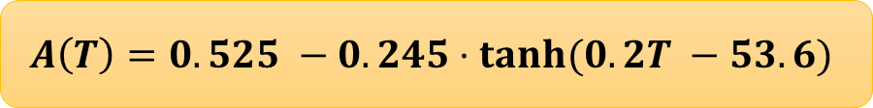
Surface Albedo
$$C\frac{∂T\left(λ, t\right)}{∂t}=S \left(1−A \right)+D\left(\frac{∂^{2}T\left(λ, t\right)}{∂λ^{2}}−\tan\left(λ\right)\frac{∂T\left(λ, t\right)}{∂λ}\right)−I(λ,t)$$
$$A\left(T\right)=0.525 −0.245⋅tanh⁡(0.2T −53.6)$$

Slide 11
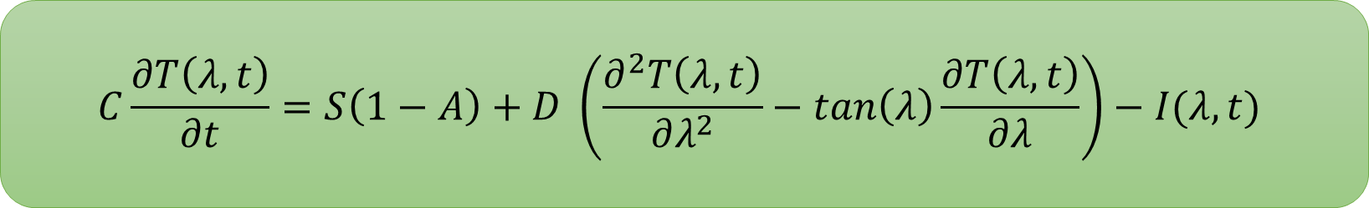
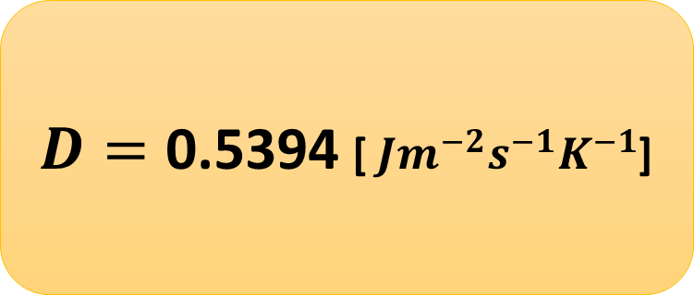
Latitudinal Heat Transport
$$C\frac{∂T\left(λ, t\right)}{∂t}=S\left(1−A\right)+D \left(\frac{∂^{2}T\left(λ, t\right)}{∂λ^{2}}−\tan\left(λ\right)\frac{∂T\left(λ, t\right)}{∂λ}\right)−I(λ,t)$$
$D=\text{0.5394}$ [ $Jm^{−2}s^{−1}K^{−1}$]

Slide 12
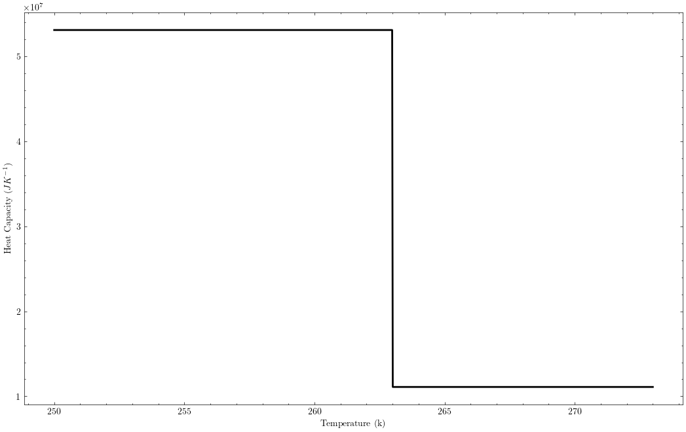
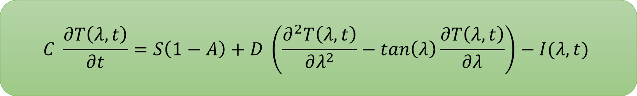

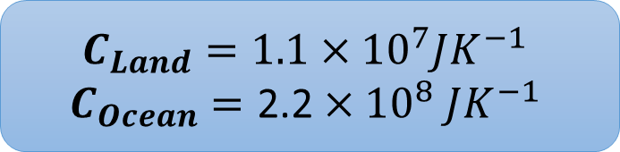
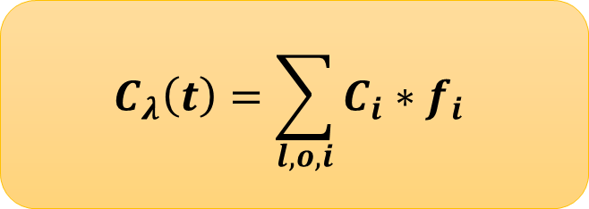
Heat Capacity
$$C \frac{∂T\left(λ, t\right)}{∂t}=S\left(1−A\right)+D \left(\frac{∂^{2}T\left(λ, t\right)}{∂λ^{2}}−\tan\left(λ\right)\frac{∂T\left(λ, t\right)}{∂λ}\right)−I(λ,t)$$
$$C_{Ice}$$
$$C_{Land}=1.1×{10}^{7}JK^{−1}$$
$$C_{Ocean}=\text{2.2}×{10}^{8} JK^{−1}$$
$$C_{λ}\left(t\right)=\sum_{l,o,i}{C_{i}∗f_{i}}$$

Slide 13
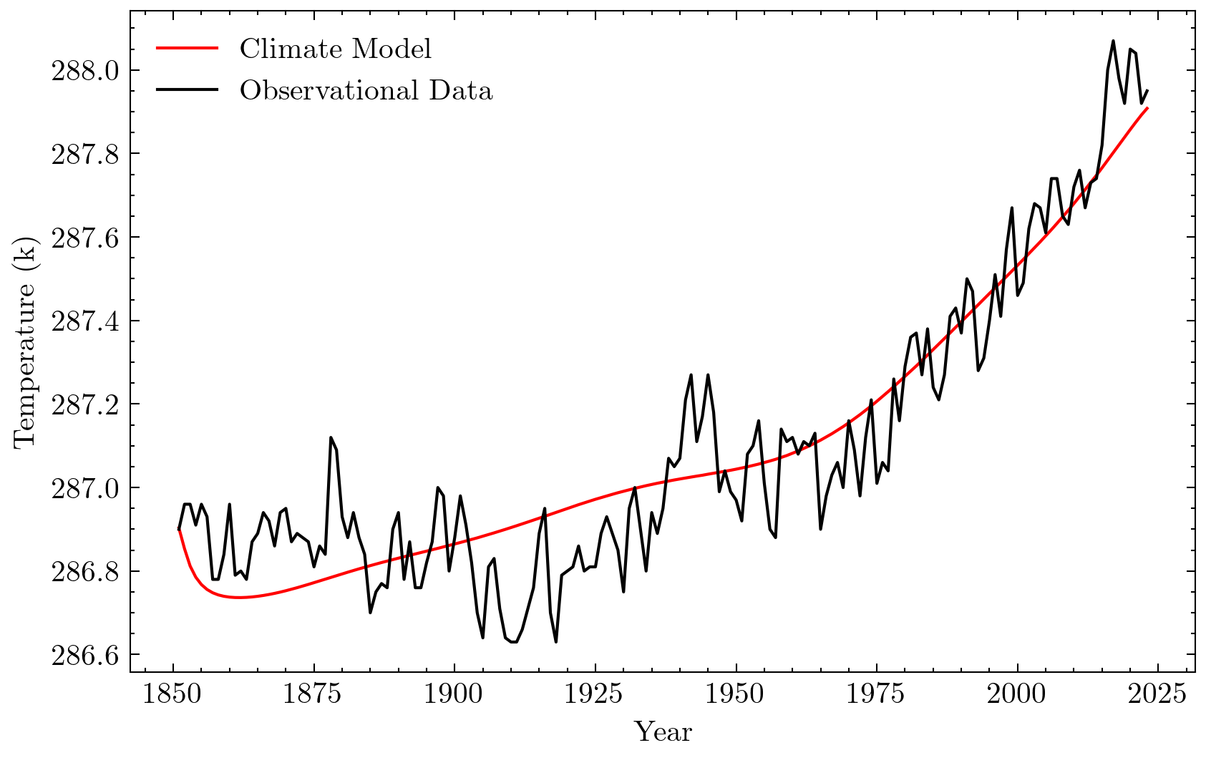
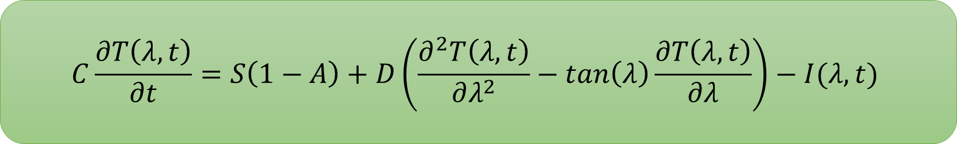
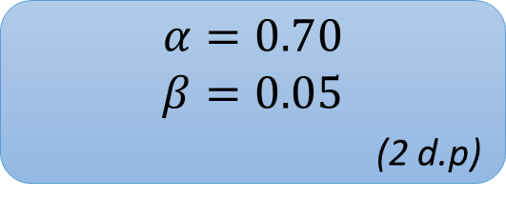
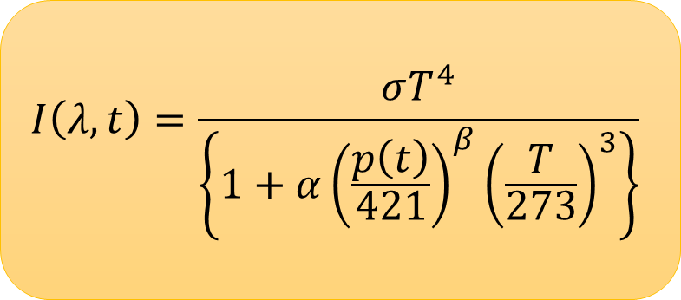
Infrared Cooling
$$C\frac{∂T\left(λ, t\right)}{∂t}=S\left(1−A\right)+D\left(\frac{∂^{2}T\left(λ, t\right)}{∂λ^{2}}−\tan\left(λ\right)\frac{∂T\left(λ, t\right)}{∂λ}\right)−I(λ,t)$$
$$I\left(λ, t\right)=\frac{σT^{4}}{\left\{1+α{\left(\frac{p\left(t\right)}{421}\right)}^{β}{\left(\frac{T}{273}\right)}^{3}\right\}}$$
$α=0.70$
$β=0.05$
(2 d.p)

